Slide 1
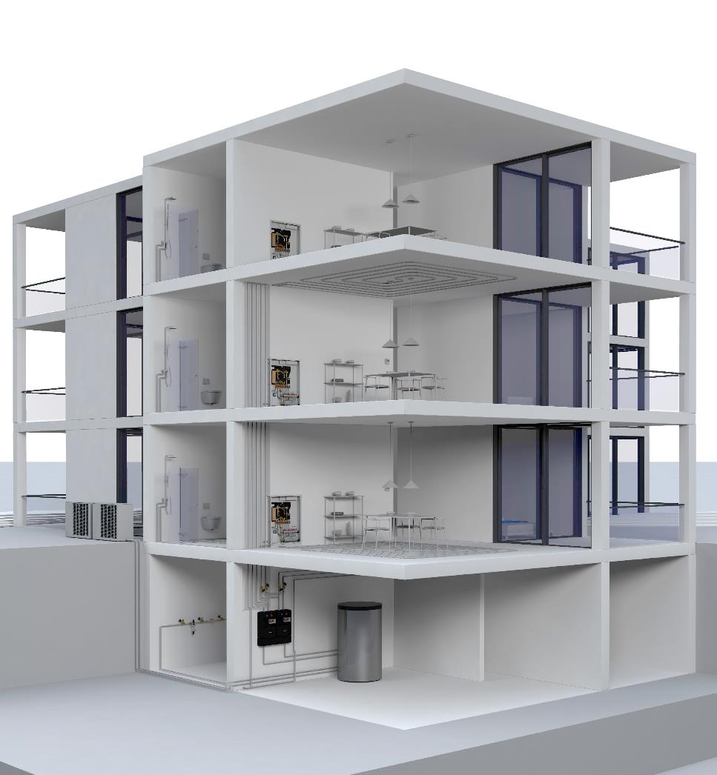
Aquanova Systems
Hygienically Fresh Hot Water
Aquastrom, Regumaq, Regudis

Slide 2



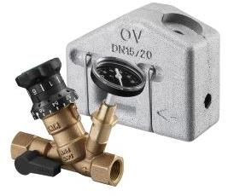
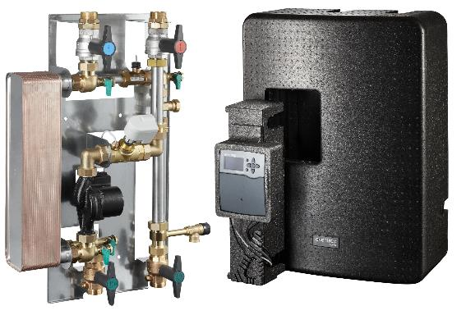
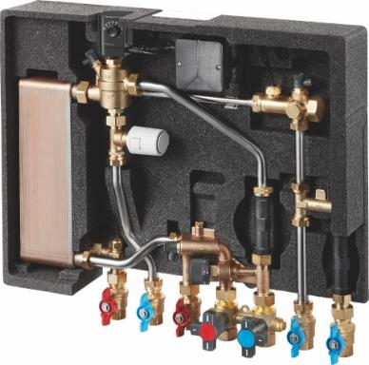
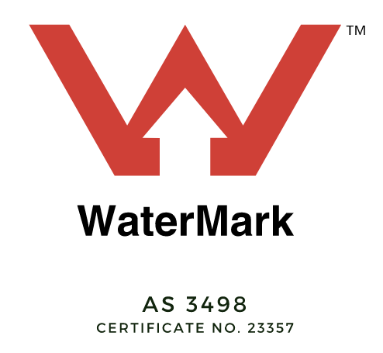
Aquanova Product Range
made
in
Germany
Hygienically Fresh Domestic Hot Water (DHW)
Decentralised Stations
for DHW Preparation &
Space Heating (HIU)
Balancing Valves
for Potable Water
Centralised Stations
for DHW Preparation
Aquastrom
Regumaq
Regudis

Slide 3


Our Company

Slide 4
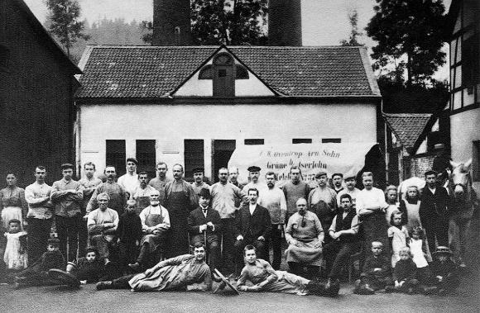

History
Over 170 + Years of Oventrop
Est. 1851
Notes:
Established in 1851, Oventrop is an independent, family-owned German manufacturer of high-quality flow & pressure control valves and many other products.
Oventrop was one of the first companies ever certified according to DIN EN ISO 9001.

Slide 5
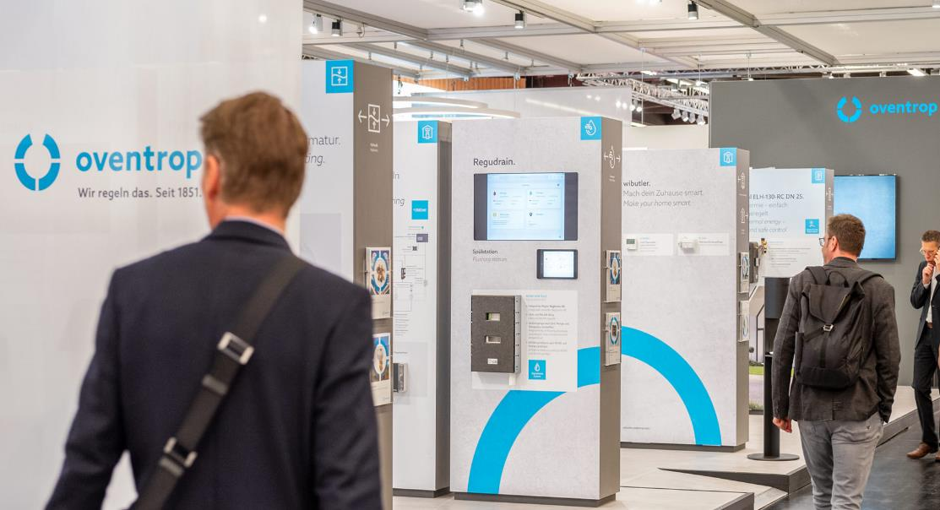
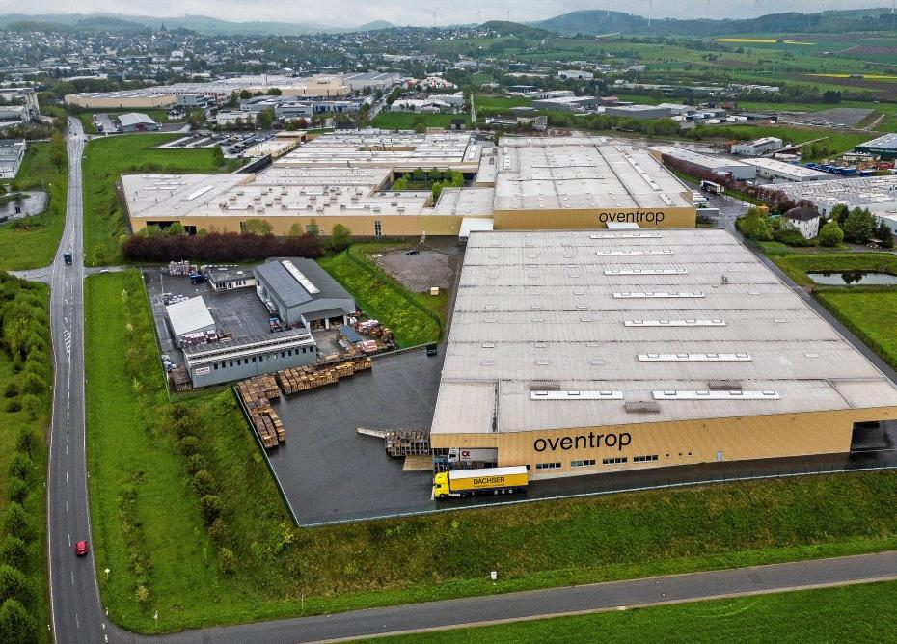

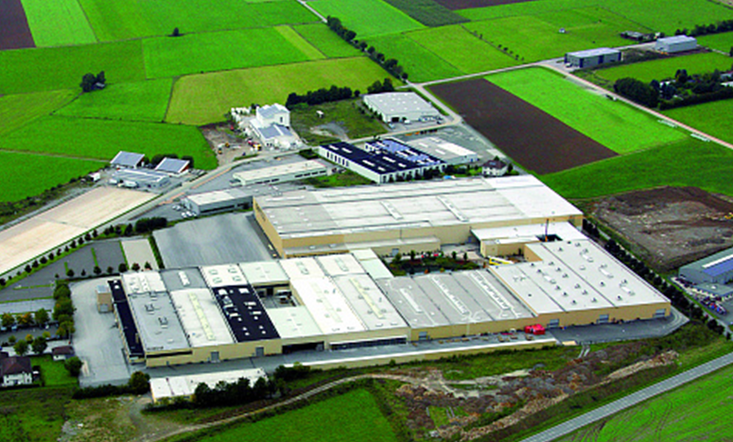
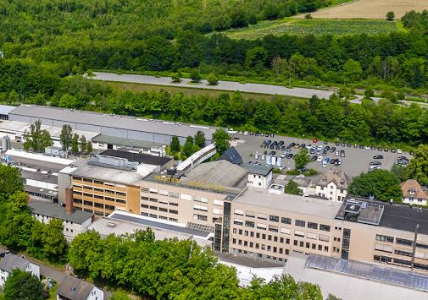
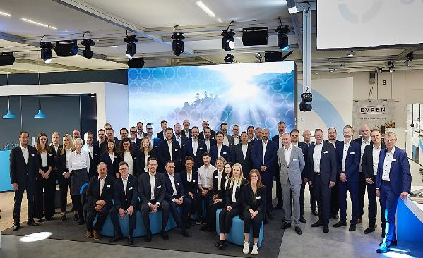
Notes:
Oventrop has transformed into a global leader in research and development of balancing valves, flow and pressure control valves, and HVAC components for the building industry. It has a reputation for its quality products and continues producing them in Germany, with its production facilities located in Olsberg, Brilon, Szydłowiec, and Tianjin.

Slide 6





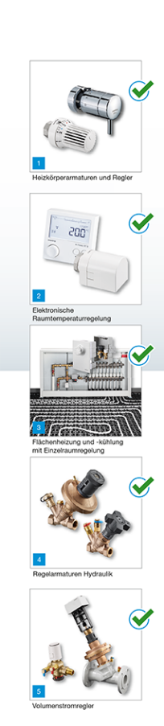
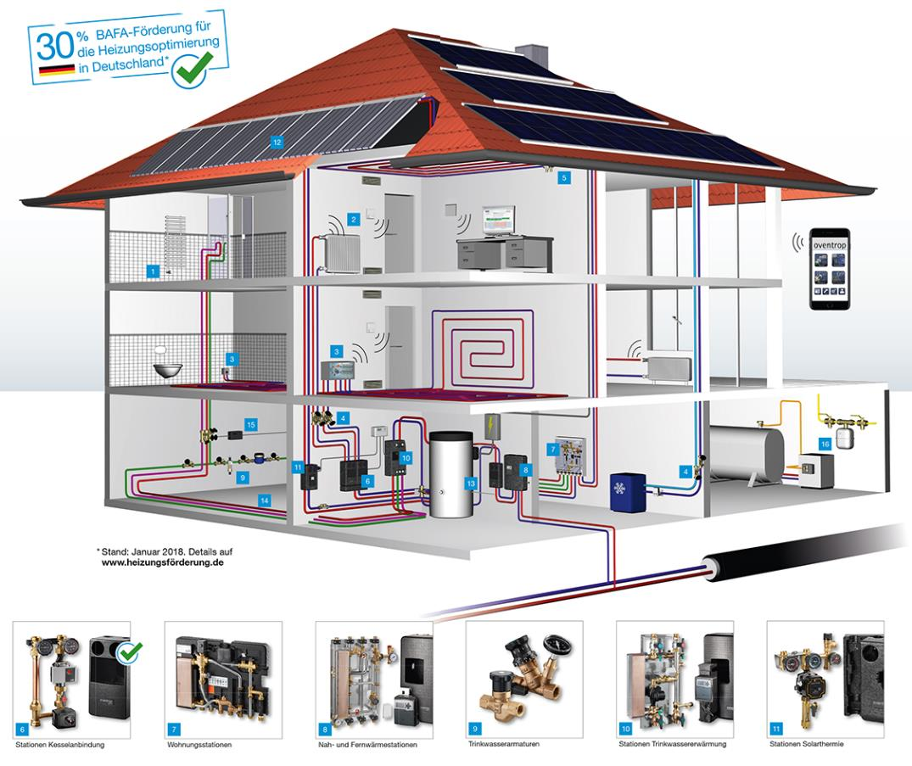

Expertise
Potable water
Hydronics
Stations
Room climate
Heating, Cooling, Potable Water
Notes:
5500+ products

Slide 7
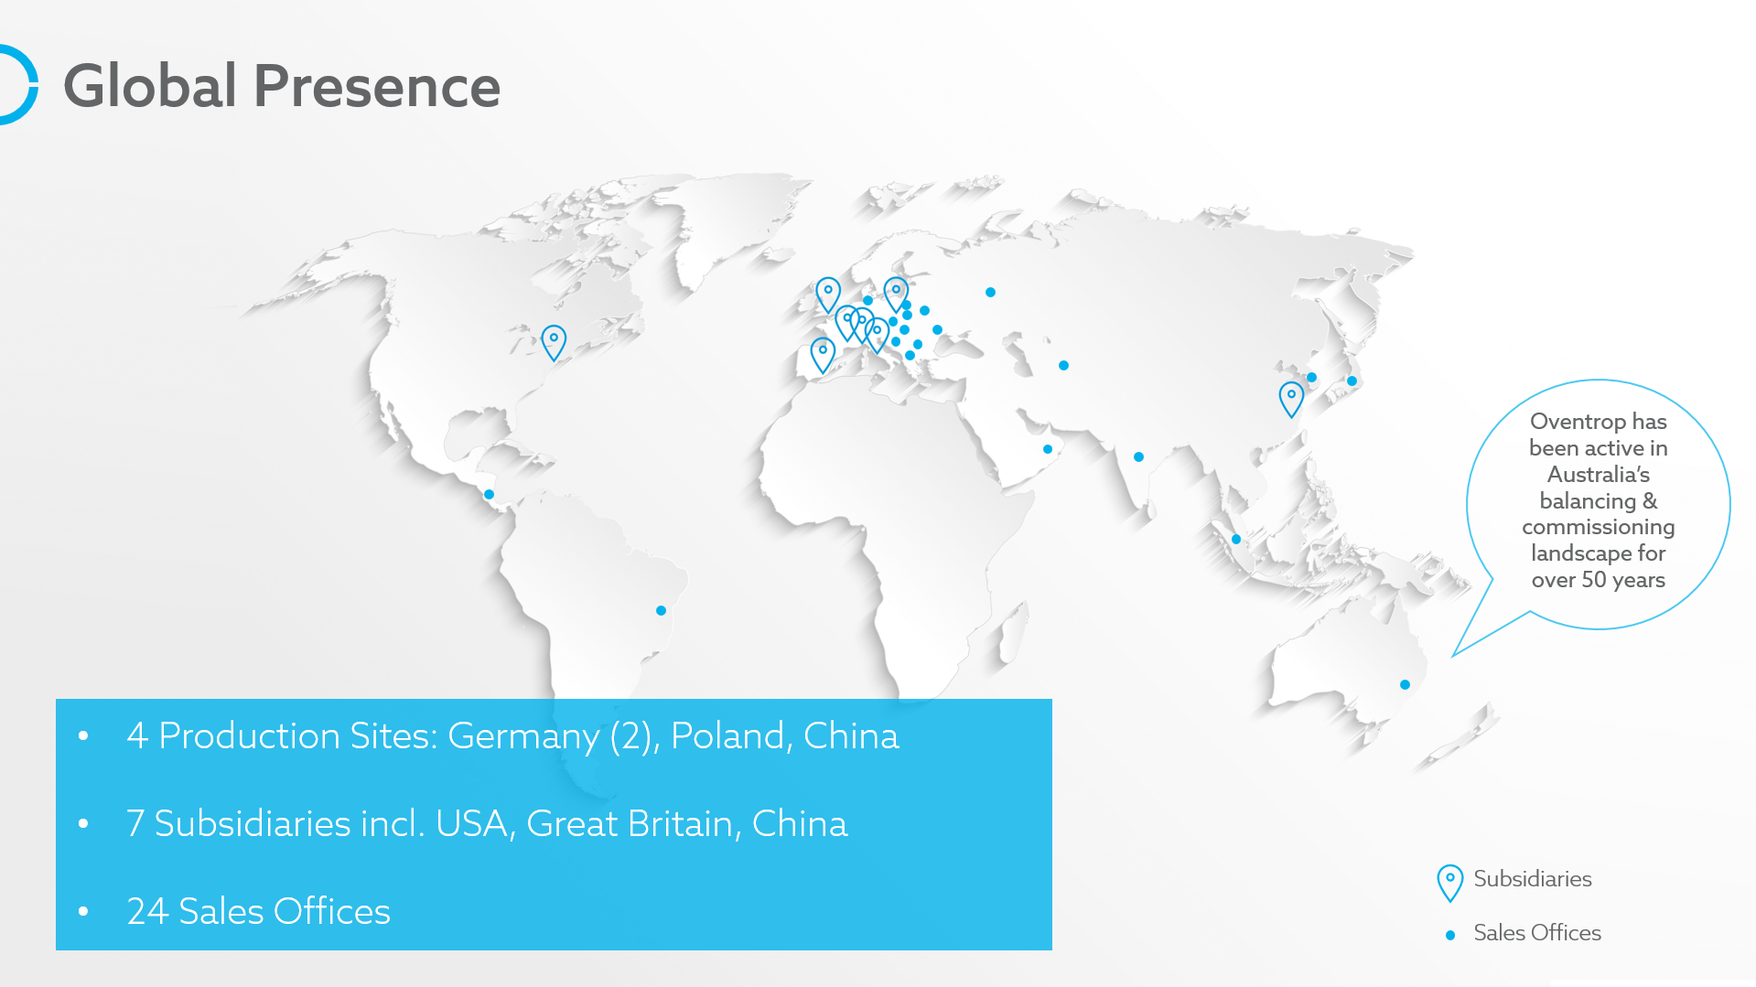
Presence
Global Footprint
Notes:
Oventrop has been part of Australia’s balancing and commissioning landscape since the early 1970’s. With a presence in every state, it has been particularly active and successful in NSW and QLD.

Slide 8
Overview
Facts & Figures
€ 300m
annual turnover
1200+
employees
5500+
product portfolio
35x
sites and representations
Notes:
Oventrop has won over fifty (50) design and innovation awards (more than any other company in the industry) from panels worldwide, including the prestigious German Innovation Award in 2019 and the highly coveted Red Dot Design Award (twice; once for the Cocon QTZ PICV in 2018).

Slide 9


Support
Assist
OV Assist
Free Services:
Pipe sizing
Balancing valve selection
Balancing valve set points
Evaluation of existing installations
On-site training and trouble shooting
Complete system schematic for DHW and DCW

Slide 10
Stations
Hot Potable Water Preparation

Slide 11
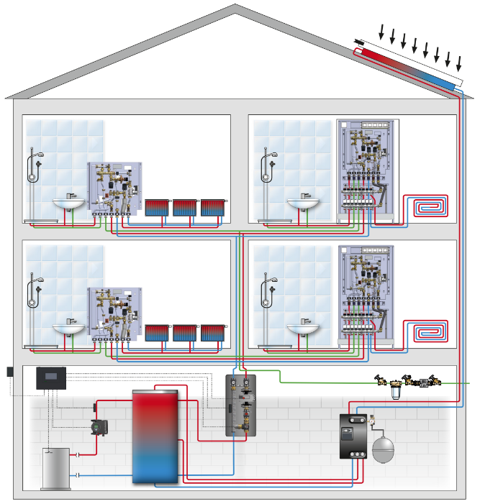
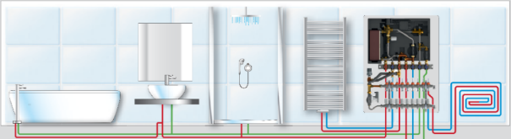
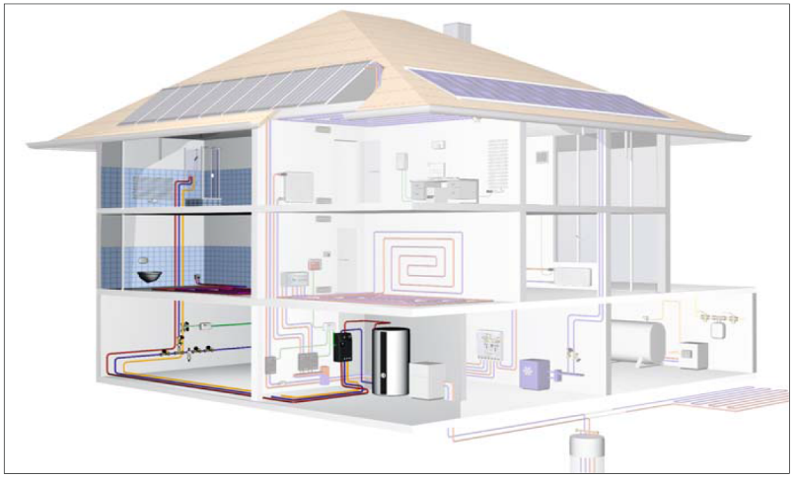
Stations
Types of Potable Water Preparation
DECENTRALISED
local potable HW production
from central heat generator/buffer
CENTRALISED
central potable HW production w/ return circulation
Regumaq X
Regudis W
dwelling station w/ optional space heating support
Notes:
Two types… Centralised and Decentralised
Key difference between traditional DHW systems you’re familiar with
Instead of a large primary DHW network where potable water is heated, stored at high temperature, distributed throughout the network, and regulated by TMVs to deliver design temperature to taps as required… instead, we’re talking about a primary/secondary system. Primary mechanical water, secondary potable water.
Regumaq/Centralised: Large secondary potable water network still required throughout building, but no DHW storage required. Heat loading takes place on the primary side within mechanical water buffer storage tanks. Balancing of DHW recirculation systems still required.
Regudis/Decentralised/Local: Small secondary potable water network required (i.e. <10m pipework from each Regudis dwelling station). Again, heat is stored on primary side in mechanical water buffer stores. The primary system is large in this case to offset the small secondary, however, we utilise the building’s existing mechanical HHW network.

Slide 12
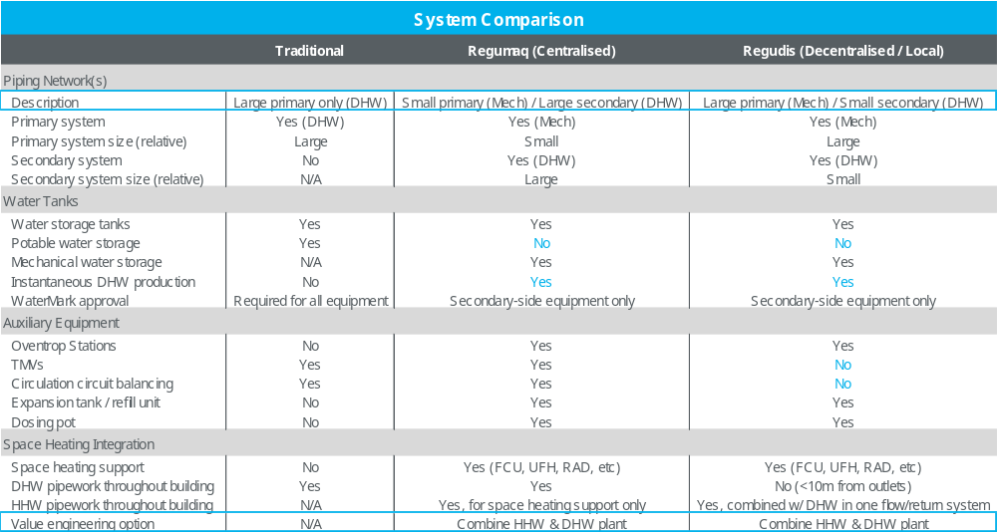

Slide 13
Regumaq X
Centralised
Hygienically Fresh
Hot Water Stations

Slide 15
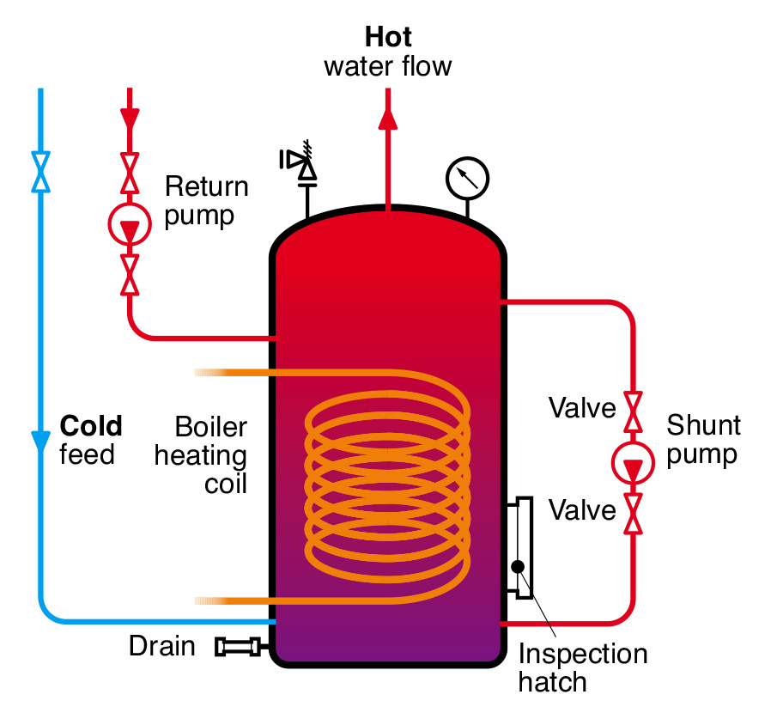
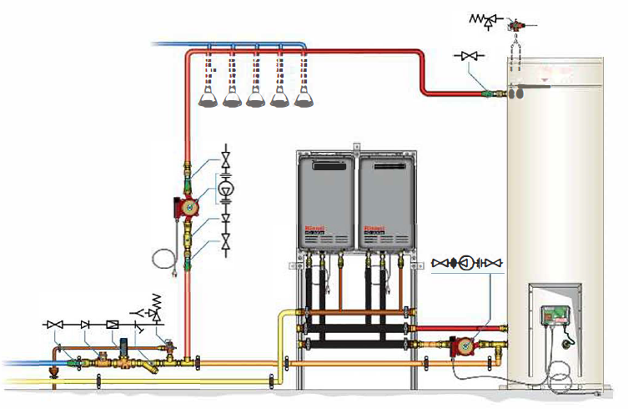
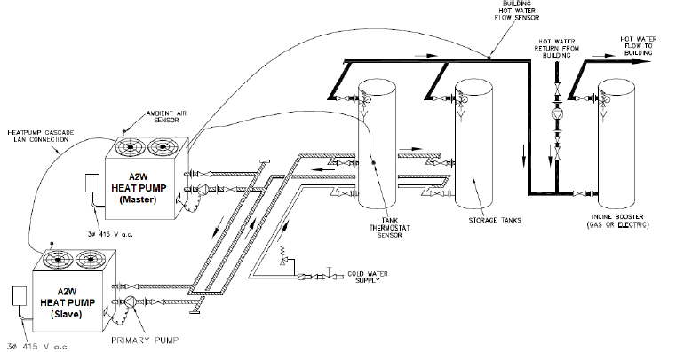
Traditional Design Examples
Potable Hot Water Preparation via
Boiler/Calorifier/HP + Potable Water Storage
(Primary DHW System)
Notes:
Demonstrating traditional/current DHW approach (gas boiler/HP supplying hot water to a domestic-side tank, ready for use, in advance of demand.
All equipment must have WaterMark approval.
Primary (potable) system.

Slide 16
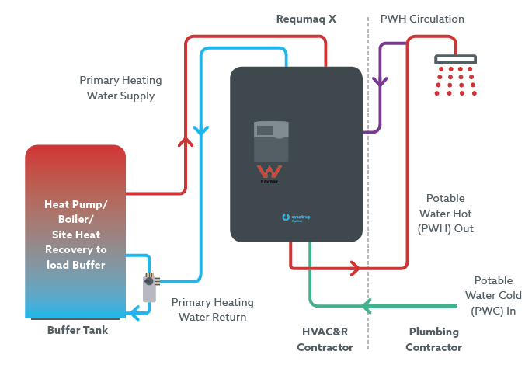
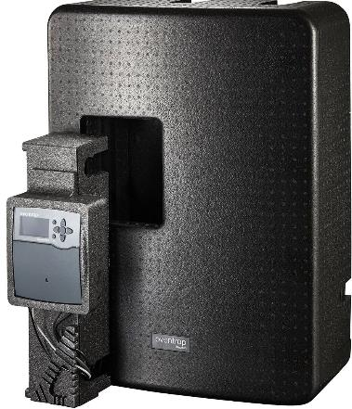

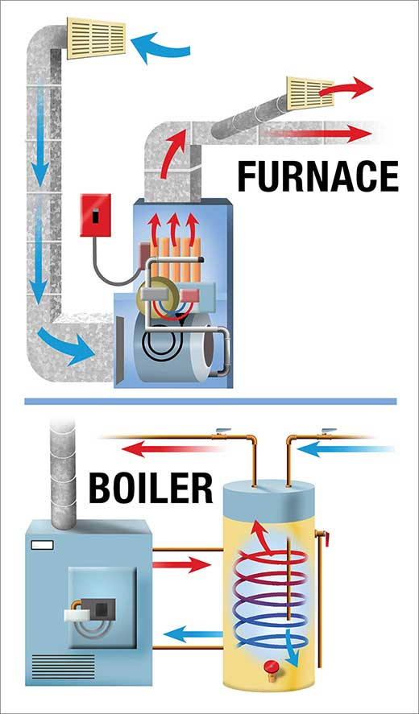

Contemporary Design
Potable Hot Water Preparation via
Regumaq Fresh Water Station
Regumaq X-80
PWH Circ.
Heat Pump
Primary
Heating Supply
(mechanical water)
Site Heat Recovery
Geothermal
Solar Thermal
Gas Boiler
Secondary Potable Hot Water Out
Potable Cold Water In (PWC)
Primary
Heating Return
(mechanical water)
Buffer Tank
HVAC-R Contractor
Plumbing Contractor
Notes:
Hygienically superior solution as tank stores non-potable primary HHW, which is held until it’s needed by the Regumaq unit to produce potable hot water instantaneously for use at the taps.
The Regumaq maintains the return circulation temperature (demonstrated by purple line).
Demarcation between contractor responsibilities shown.
No WaterMark required on any equipment serving primary mechanical system.
Primary (mechanical) / Secondary (potable) system.
Multiple heat generators can be utilised to capture heat.

Slide 17
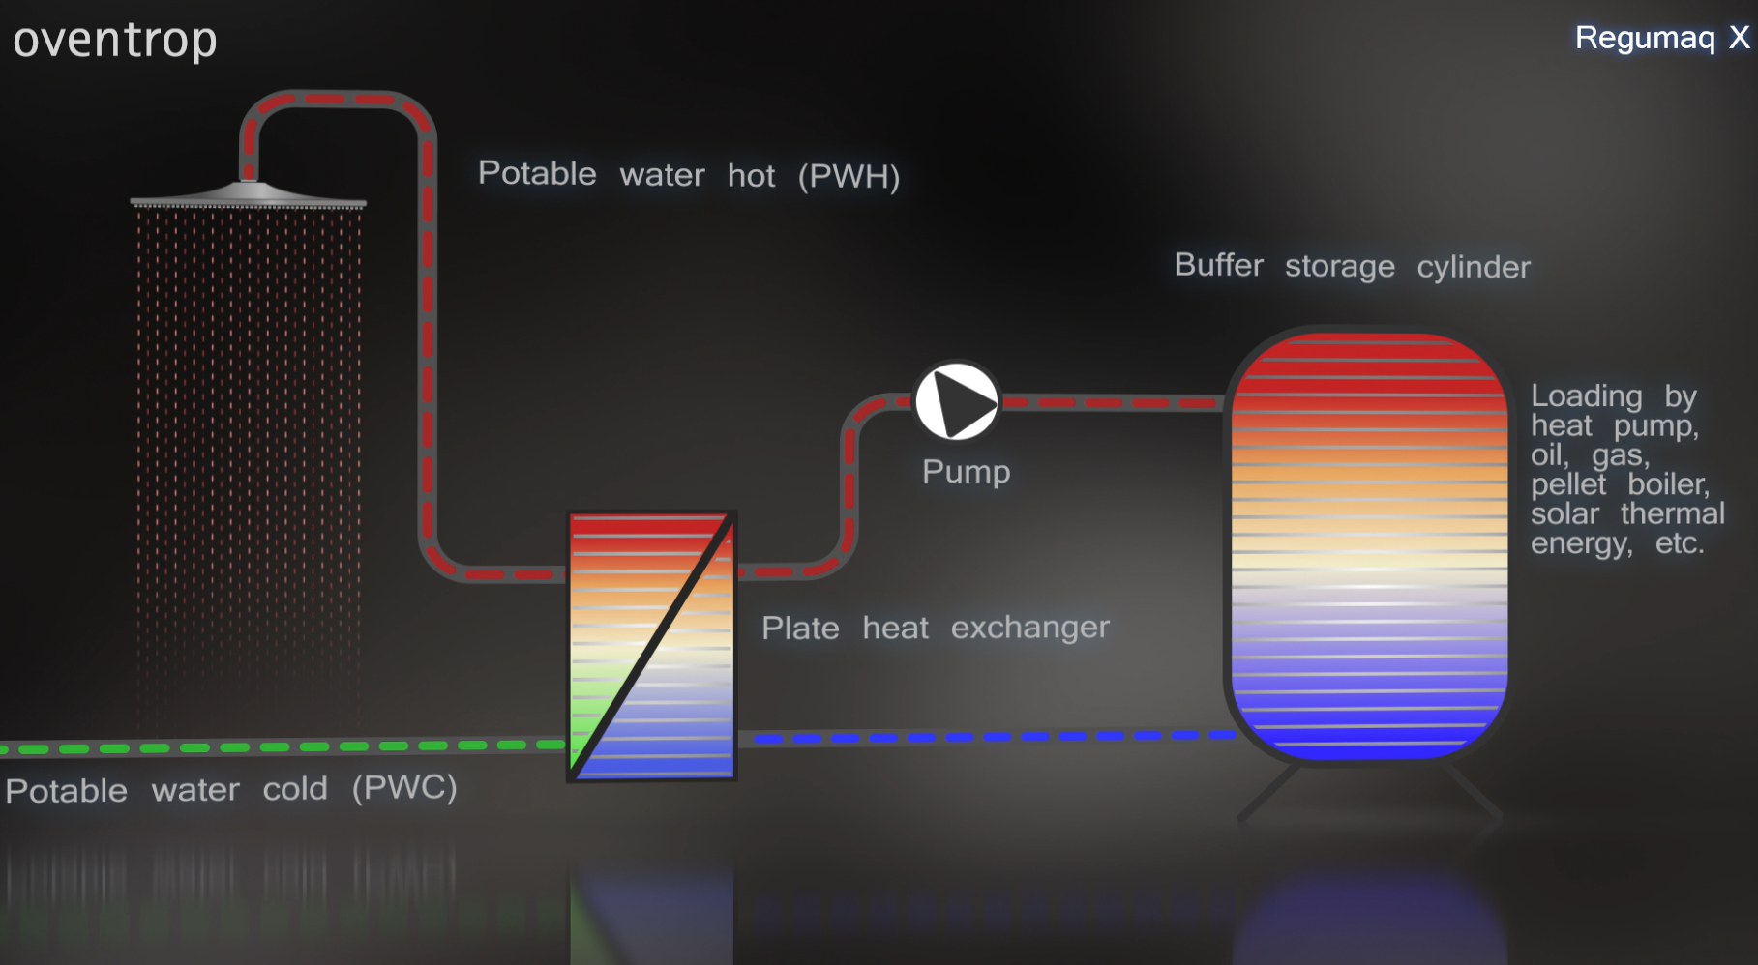
BMS
Regumaq X
T
Direct plate heat exchanger cold to hot water production. Primary heat via variable speed pump and thermal store. Thermal store loaded via available heat source.
DHW temp kept to setpoint with sensor and variable speed primary heating water volume flow, delivering current hot water production demand over the plate heat exchanger.
Notes:
System drawing indicating direct plate heat exchanger cold to hot water production. Primary heat via variable speed pump and the thermal store.
Thermal store loaded via site’s available heat generator sources; get heat in the tank however you can (i.e., heat rejection, solar, whatever; we’ll take free energy wherever possible)
DHW temperature is kept to setpoint with a sensor & variable speed primary heating water volume flow pump, delivering the current hot water production demand over the plate heat exchanger. Therefore, as the demand increases, the pump speeds up, as the demand reduces, the pump slows.

Slide 18
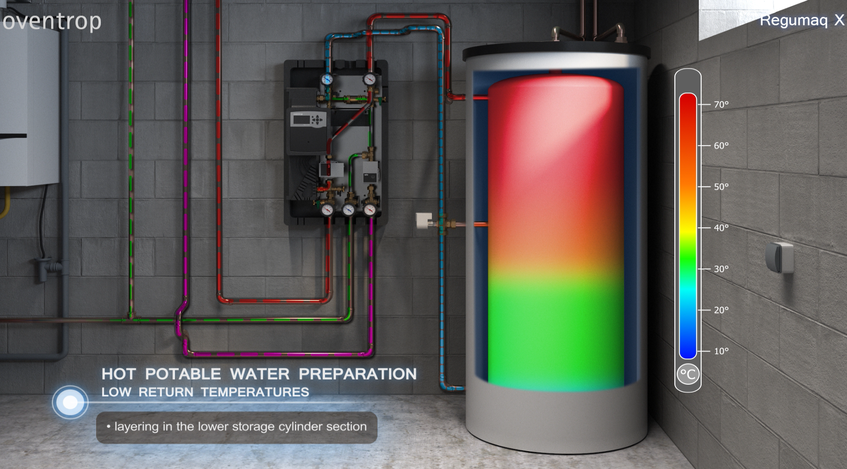
Thermal store loading & usage ensures:
Max. efficiency always delivered from heat generator (boiler, HP, etc)
Realisation of boiler capacity and HP max. COP possible
Notes:
Demonstrating high volume DHW production where the return from the Regumaq is blue to the bottom of tank

Slide 19
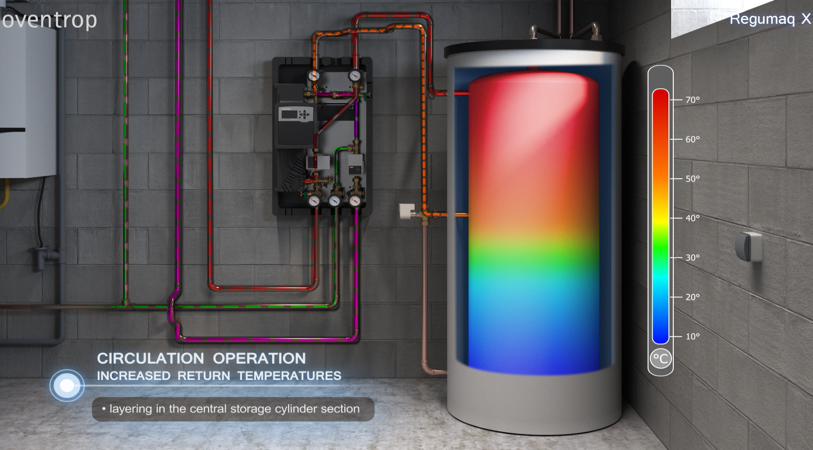
Designed to intelligently manage DHW production and recirculation loop temperature, minimising waste and maximising energy efficiency
Tank layering maintained, heat generator efficiencies maintained, and primary return water energy is reused during times of low load DHW production or recirculation loop temp management.
Notes:
Thermal store return (during low load DHW production) or return circulation temperature maintenance (purple line) is managed via a diverting valve to the centre of thermal store.
This ensure tank layering and heat generator efficiencies are maintained, and primary return water energy is re-used during times of low load production.

Slide 20
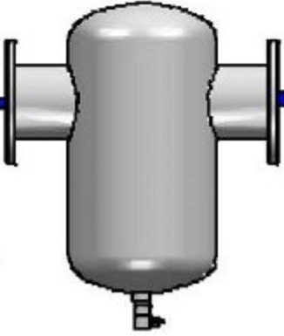
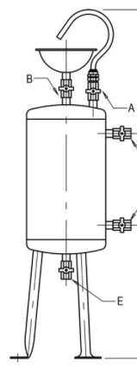

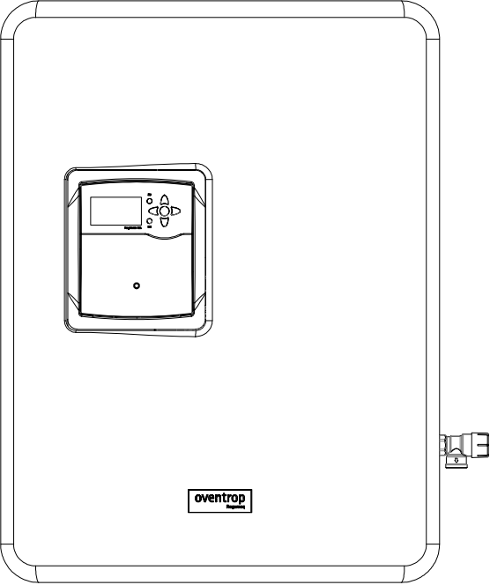



Regumaq X Next Generation DHW
Typical Layout Primary HHW with Low ΔT (HP up to 65°C, or Boiler)
PRIMARY HHW (MECHANICAL)
Air/Dirt Separator
SECONDARY (POTABLE) DHW
Chemical
Dosing Pot
65°C Primary HHW Flow
T
Buffer
Vessel
1,500 L
Buffer Vessel
1,500 L
Buffer Vessel
1,500 L
T
Heat
Pump
ΔT = 9K
X80
X80
X80
X80
230V
50Hz
230V
50Hz
230V
50Hz
230V
50Hz
28°C Primary HHW Return
PICV
M
53°C DHWR Recirculation
Heat Pump controller to regulate
3-way valve actuator to maintain
min return water temperature of 56°C.
PICV (no actuator) & metering station to always ensure HP design return flow rate
60°C DHW
Check
Valve
Strainer
PRV
RPZ
5-20°C DCW
Expansion Tank
(location TBC)
Vertical stratification - buffer storage temperature layering
Notes:
Regumaq efficiency statement
- During low to medium domestic secondary side demand, return circulation water mixes with Regumaq inlet cold water, resulting in a lower cold to hot temperature rise to produce the 60°C DHW secondary for fixtures. This reduced temperature rise enhances efficiency compared to other 60°C DHW solutions.
- The domestic hot water temperature typically rises between 35/40°C to 60°C, compared to the usual 10°C to 60°C rise in other systems. This superior energy utilisation in the return water system also maintains the expected hygiene standards for our region.
- This efficiency does not apply to high delta T CO2 systems unless peak domestic secondary side demand is 2L/s or less. However, low delta T heat generators do benefit from this improved efficiency and energy savings all day every day 365 days a year.

Slide 21
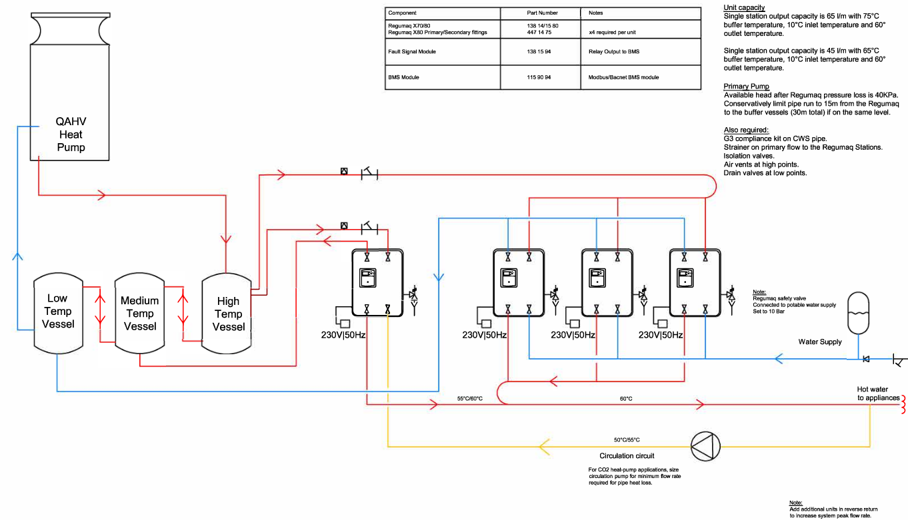



Regumaq X Next Generation DHW
High Temp CO2 HP Layout for High ΔT & COP Optimisation (Large DHW Volume)
High Temp
Heat Pump
Horizontal stratification - buffer storage temperature layering
(ensures design ΔT across high temp HP = 100% efficiency at all times)
Low Temp Vessel
Med Temp Vessel
High Temp Vessel
X80 Unit
X80 Unit
X80 Unit
X80 Unit
Regumaq safety valve connected to potable water supply.
Set to 10 bar.
Low Temp Vessel
Med Temp Vessel
High Temp Vessel
230V/50Hz
230V/50Hz
230V/50Hz
230V/50Hz
DCW Supply
55°C/60°C
60°C
Hot water to appliances
50°C/55°C
Circulation circuit
Note: Add additional units in reverse return to increase system peak flow rate
Notes:
Key difference is the storage temperature layering is over each tank as opposed to within a single tank with vertical stratification. This ensures 100% efficiency for heat pumps by keeping return temps to HP at design at all times regardless of system demand, which is not possible for traditional designs.

Slide 22

Regumaq X Next Generation DHW
High Temp CO2 HP Layout for High ΔT & COP Optimisation (Small-Medium DHW Volume)
Horizontal stratification - buffer storage temperature layering
(ensures design ΔT across high temp HP = 100% efficiency at all times)
High Temp Heat Pump
High Temp
Heat Pump
Low Temp Vessel
High Temp Vessel
X80 Unit
X80 Unit
X80 Unit
Regumaq safety valve connected to potable water supply.
Set to 10 bar.
X45 Unit
Low Temperature Vessel
High Temperature Vessel
230V/50Hz
230V/50Hz
230V/50Hz
230V/50Hz
Water Supply
55°C/60°C
Hot water to appliances
60°C
50°C/55°C
Circulation circuit
Note: Add units in reverse return to increase system peak flow rate
Notes:
Key difference is smaller plant – stratification over two tanks only. Again, 100% efficiency for heat pumps maintained for same reason noted below previous slide.

Slide 23
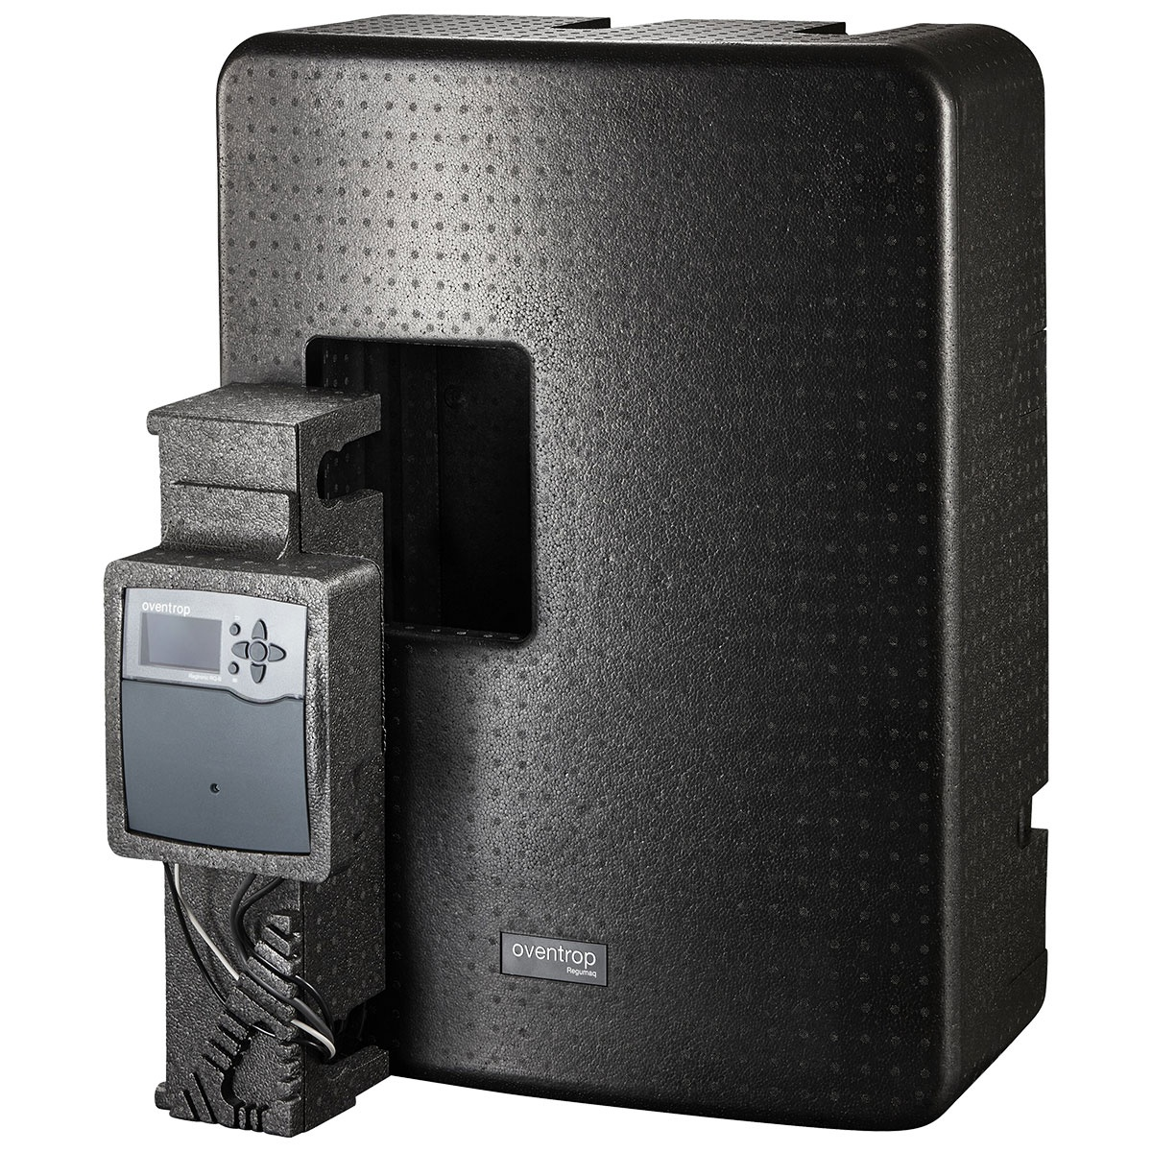
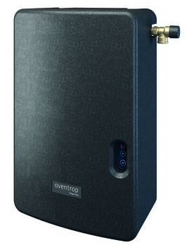
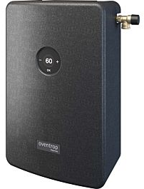
Dimensions
Regumaq Centralised Stations
660 mm
400 mm
400 mm
875 mm
625 mm
240 mm
240 mm
300 mm
X-25
X-45
X-80

Slide 24
Regudis W
Decentralised / Local
Hygienically Fresh Hot Water
& Space Heating (HIU)

Slide 26

Regudis is an HIU
What is a heating interface unit?
Connects DHW & space heating (optional) to centralised heating network via same flow and return lines. Potential to combine DHW and HHW plant.
Hygienic DHW generated instantaneously on demand via plate HEX.
Supplies up to 600 L/h in space heating support (FCU/UFH/RAD).
Can be linked to existing heat networks for an instant DHW solution.

Slide 27
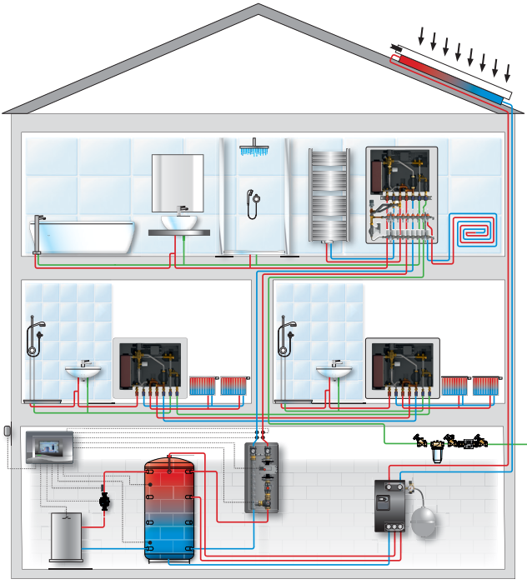
Heating Interface Units
Installation
Central heat generator plus buffer energy storage cylinder with regenerative energy tank loading possibilities
3-pipe-system:
primary HW flow
primary HW return
potable cold water
One Regudis W station per area
(i.e., hotel room, apartment, etc.)
100% efficiency for heat pumps
Notes:
Central heat generator of choice in combination with a buffer energy storage cylinder and/or regenerative energy tank loading via solar thermal or solar PV with electric element.
3-pipe-system (Primary hot water flow & return, potable cold water)
Typically 1 Regudis W-station for each area / hotel room/ dwelling / apartment / student accommodation
100% efficiency for heat pumps: possible when maintaining design dT across HP.

Slide 28
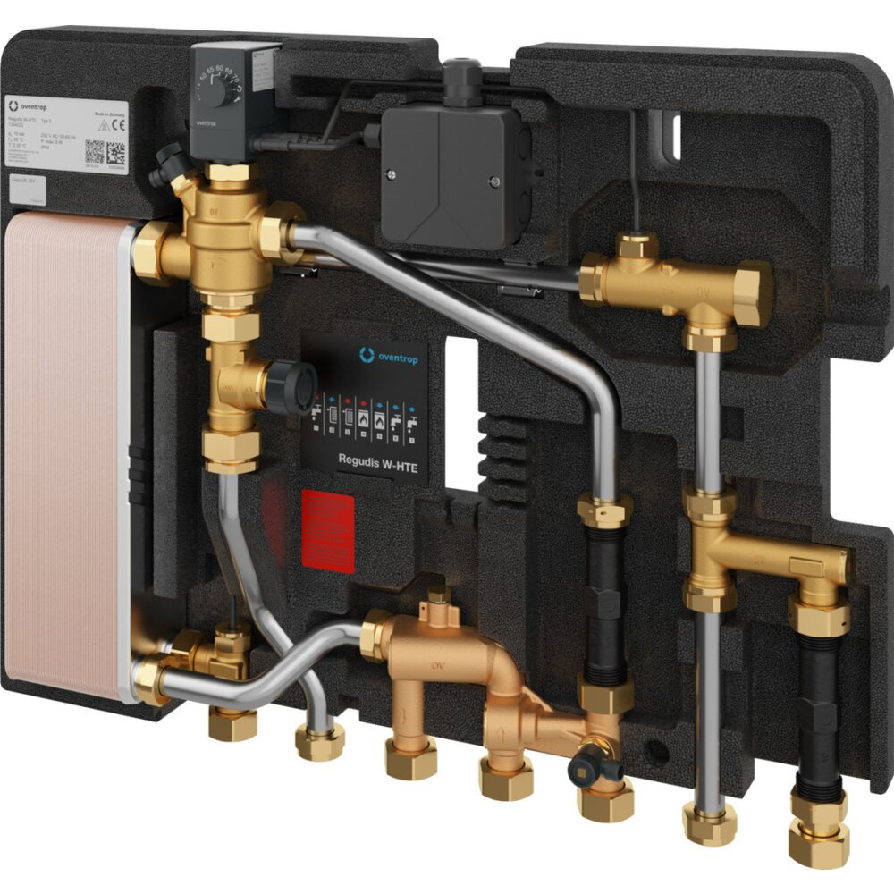
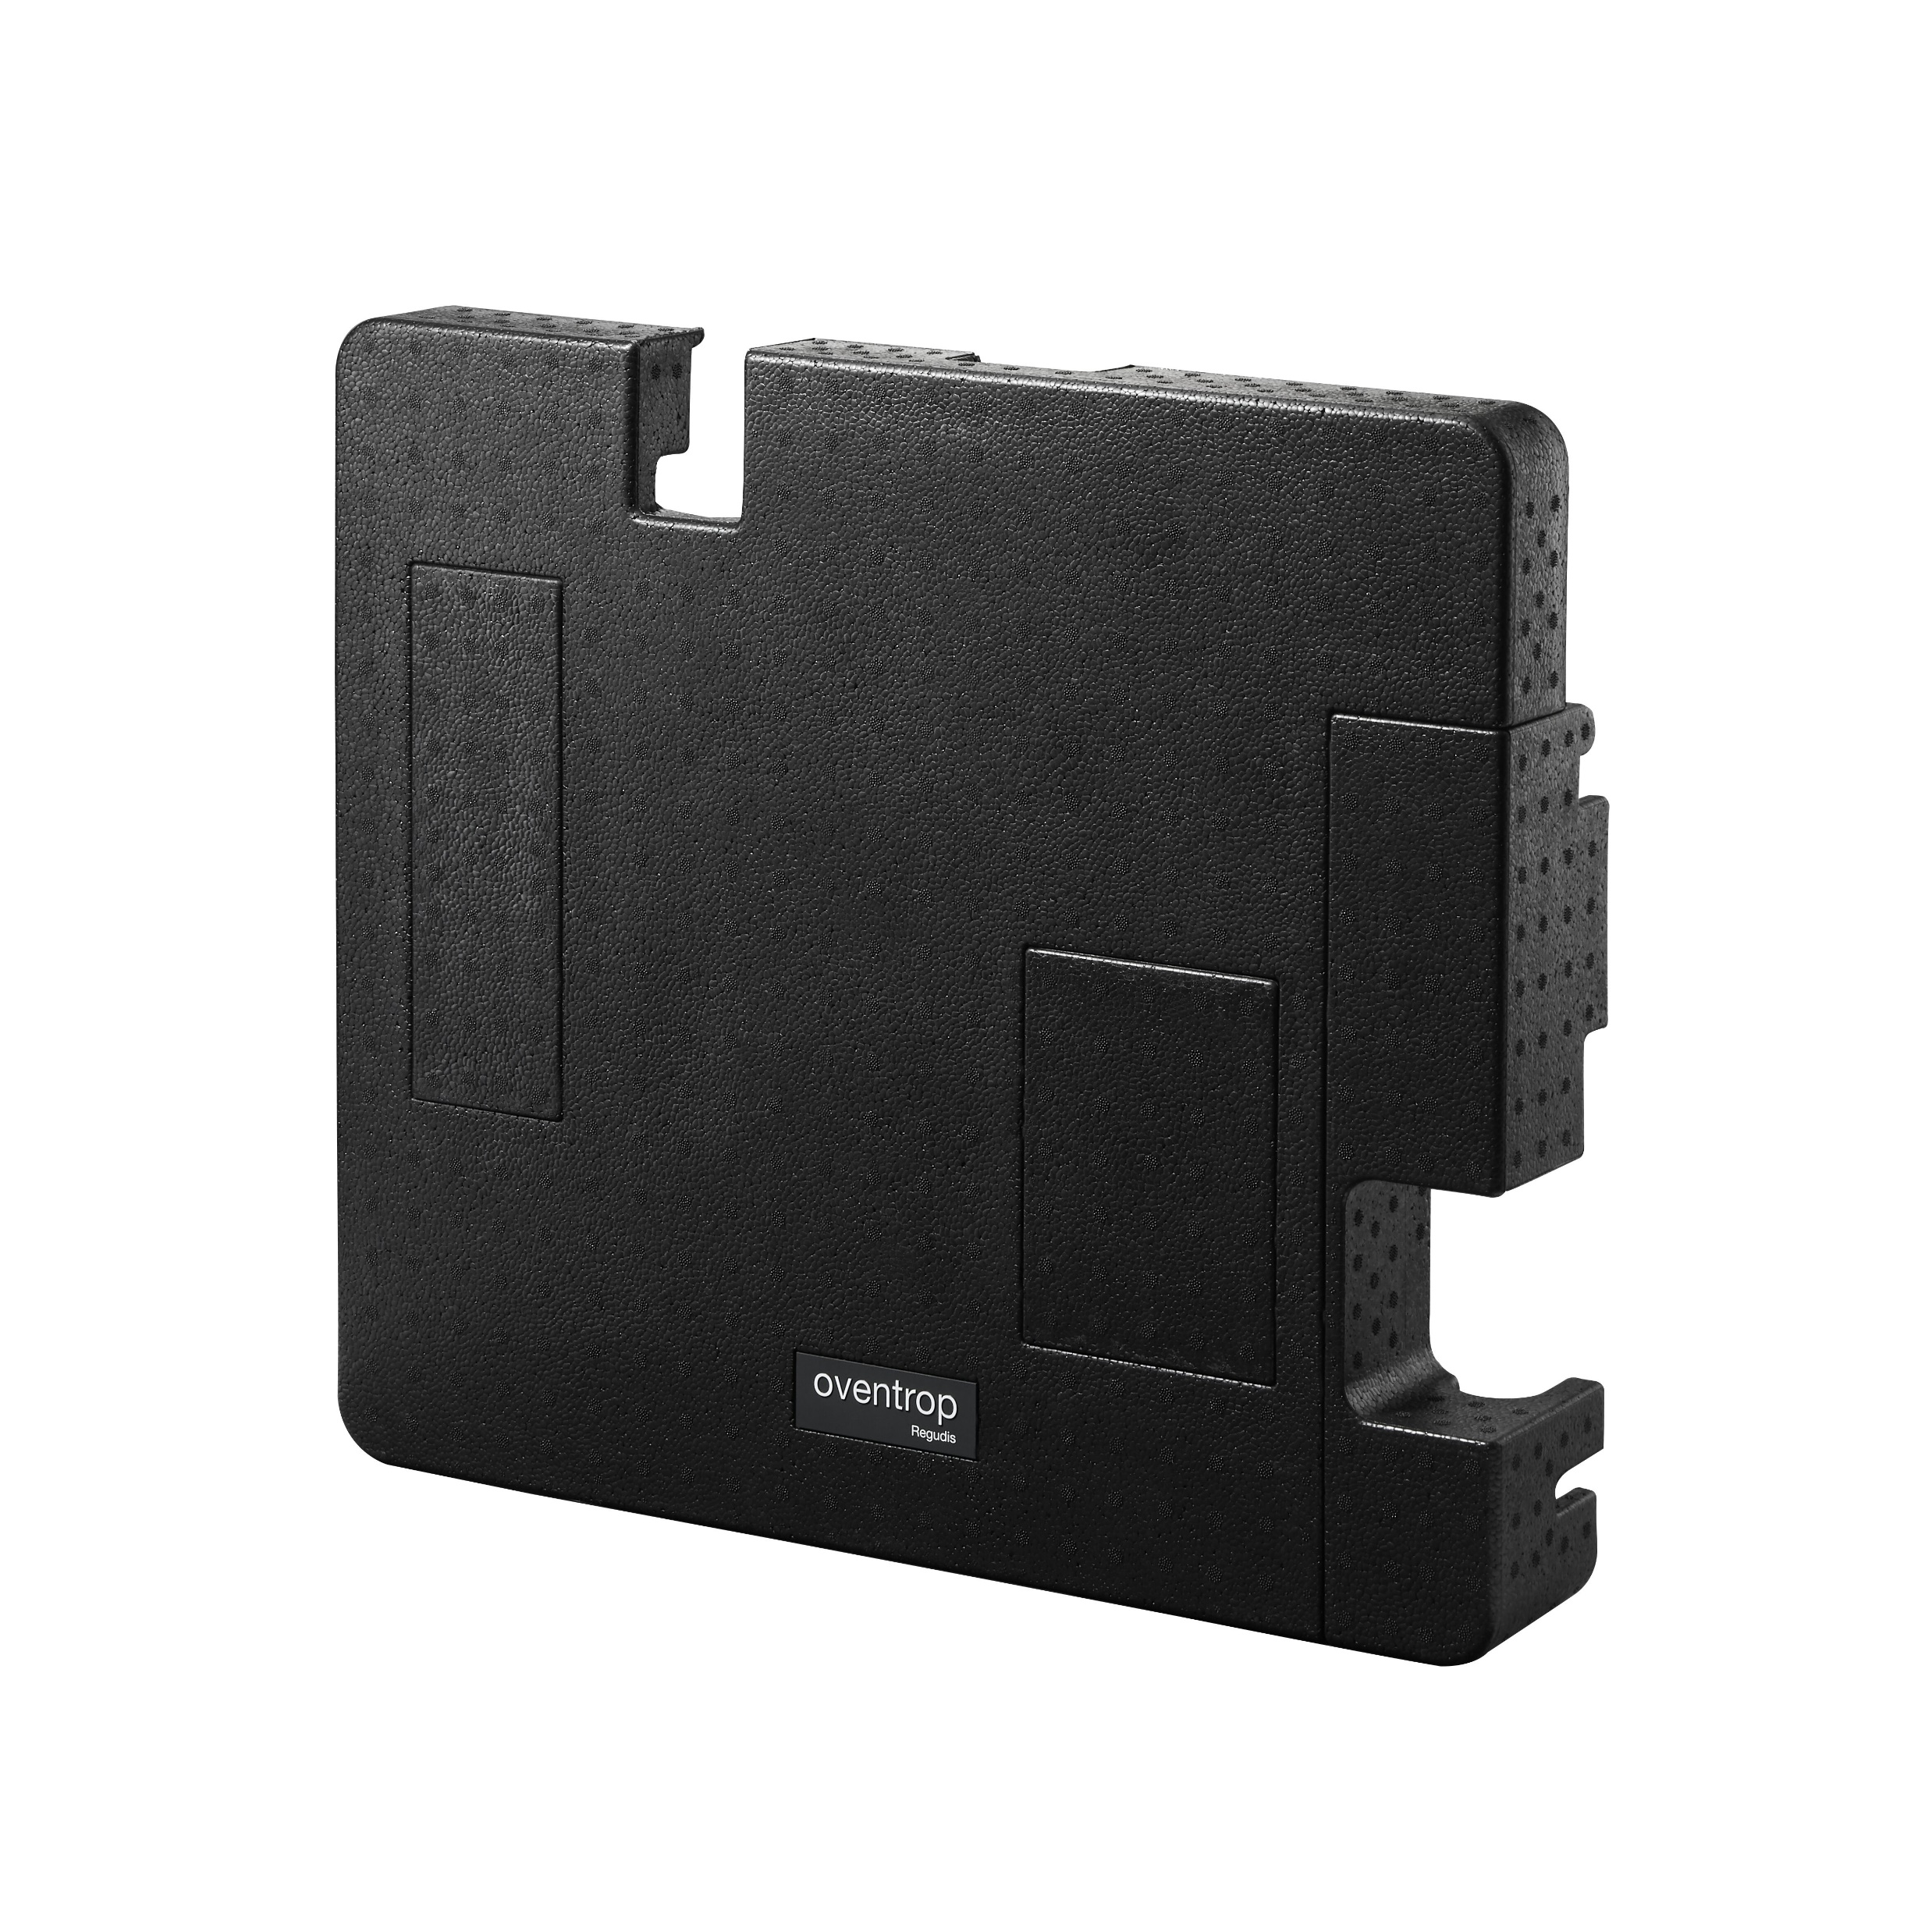
Dimensions
Regudis Decentralised Stations
600 mm
455 mm
Regudis W-HTE
Upper Insulation
110 mm
Notes:
Typically put in cupboard, laundry, behind bathroom mirror or under vanity, in cistern wall, etc.

Slide 29
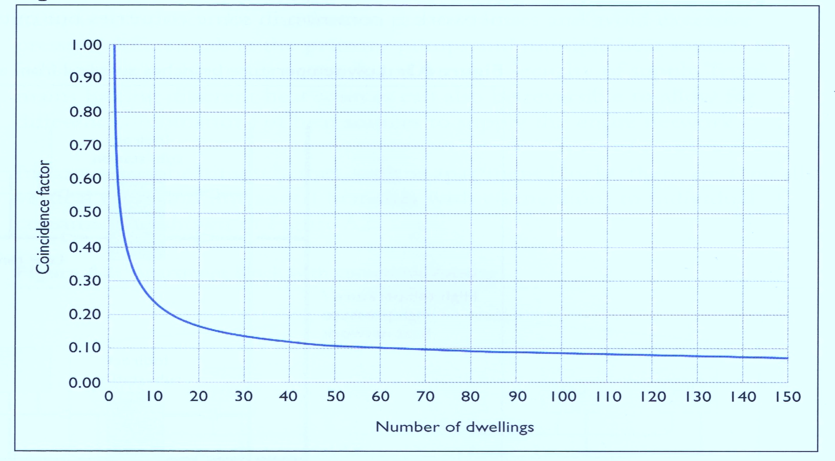
Heating Interface Units
Primary HWS Diversity / Coincidence Factor Apply
Example:
If 40 dwelling stations require 75kw plant,
140 dwelling stations require 150kw plant.
Plant size only increases 100% despite a 250% increase in the number of dwelling stations.
More stations = More diversity
Coincidence factor relates to HWS generation & depends on number of dwellings/stations installed in project.

Slide 30
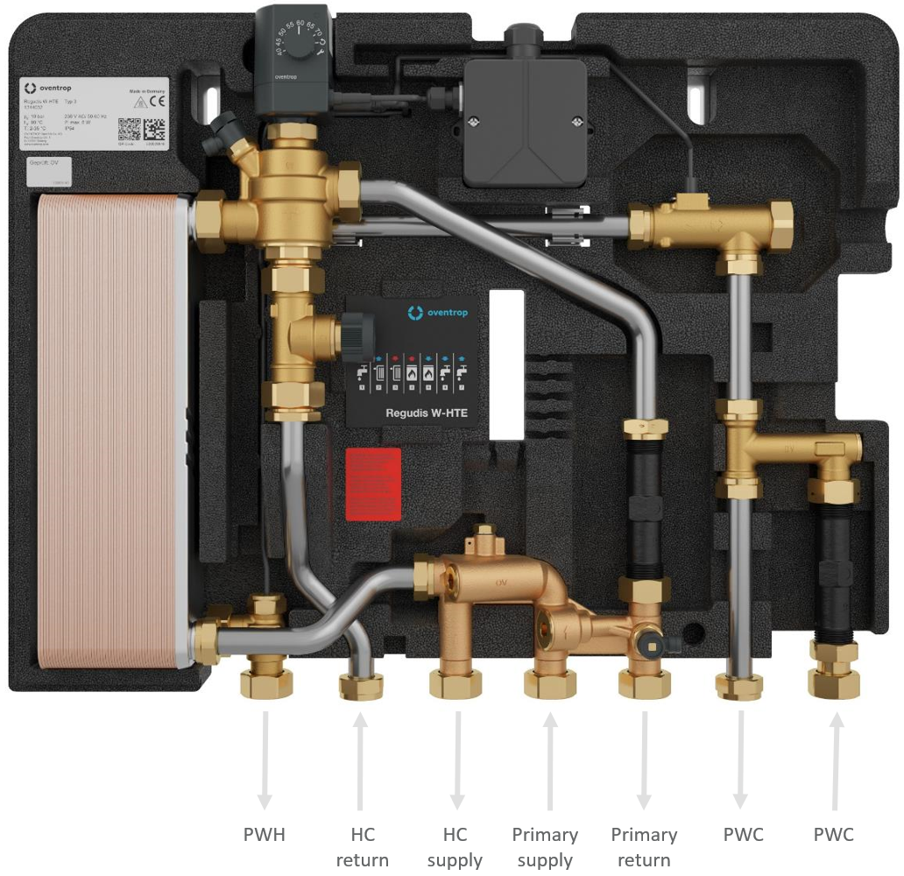
Regudis W-HTE
made
in
Germany
Application, Certification & Approvals
Approved WaterMark standard AS3498:2020 for heated water supply with ABCB WaterMark license No. 23357.
Potable warm water compliant with AS3500.4 Clause 1.9.3, approved appliance for less than 50°C systems.
Approved by NSW Health for warm and hot potable water.
Heat interface connecting fan coil units or underfloor heating or radiator primary heating water supply, one heating system.
Direct-to-tap warm water appliance = no tempering valve or TMV required = annual TMV maintenance eliminated.
As an appliance, complies with state warm water system requirements and installation standards under the Plumbing Code of Australia and the Australian Building Codes Board.
Energy consumption for billing measured by heat/energy meter installed within Regudis station, or in primary supply.
Water-usage billing also available for potable-hot-water-only systems with no space heating.
Notes:
Instantaneous hot water delivery temperature 45°C
Watermarked – Certificate No. 23357
AS 3498:2009 Certification Water Heaters
Deemed to satisfy provisions Part B2 of the Plumbing Code of Australia, water heaters and temperatures
Meets or exceed Victorian Building Authority Technical Solution Sheet 6.11 Warm Water Systems

Slide 31


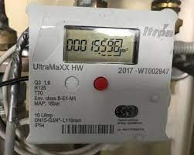
Regudis W-HTE
Metering and Billing Ready
Heat/Energy metering for
DHW & heating systems
Town cold water supply metering
DHW only metering
Notes:
ENERGY METERING to capture all heat consumed to produce DHW and/or space heating. Measures TD and flow to calculate actual kWh
TOWN WATER SUPPLY METERING to record mains water consumption of both the DHW and DCW supply
DHW ONLY METERING possible by traditional hot water usage pulse meters of DHW outlet to taps

Slide 32
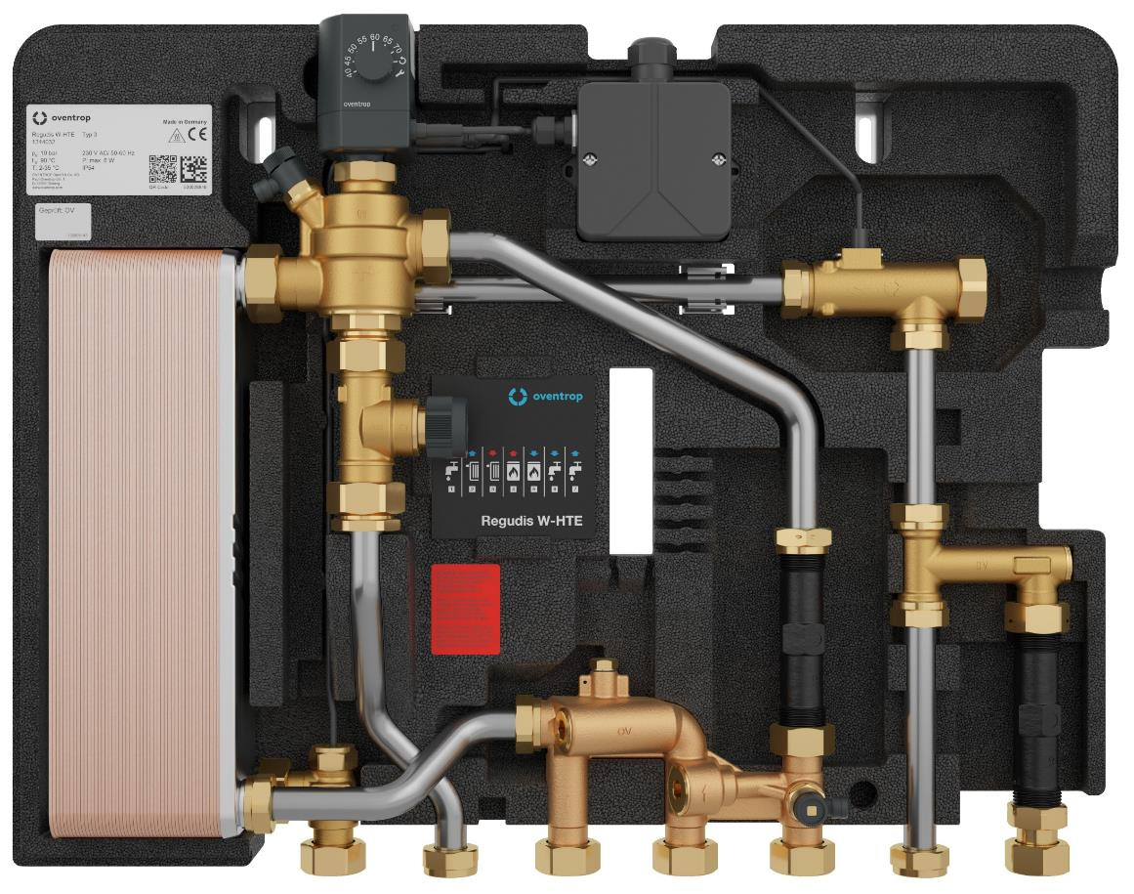
Regudis W-HTE
Heating Coil Operation
Scenario → Action
Tenant opens cold water tap
  Fresh potable cold water delivered to fixture
System calls for heating (e.g., tenant enables underfloor)
  Heating water supplied to system
  Heating circuit water cools and returns
PWH
HC
return
HC
supply
Primary
supply
Primary
return
PWC
PWC
Notes:
PWC can pass through station if cold water metering required. Else, cap PWC ports and connect directly to taps.

Slide 33
Regudis W-HTE
Heating Coil Operation
Scenario → Action
Tenant opens cold water tap
  Fresh potable cold water delivered to fixture
System calls for heating (e.g., tenant enables underfloor)
  Heating water supplied to system
  Heating circuit water cools and returns
Tenant opens hot water tap
  Heating water passes through HEX and returns
PWH
HC
return
HC
supply
Primary
supply
Primary
return
PWC
PWC
Notes:
PWC can pass through station if cold water metering required. Else, cap PWC ports and connect directly to taps.

Slide 34
Regudis W-HTE
Heating Coil Operation
Scenario → Action
Tenant opens cold water tap
  Fresh potable cold water delivered to fixture
System calls for heating (e.g., tenant enables underfloor)
  Heating water supplied to system
  Heating circuit water cools and returns
Tenant opens hot water tap
  Heating water passes through HEX and returns
  Fresh potable cold water passes through HEX and heats instantaneously on its way to the fixture
Note: Heating water used simultaneously for space heating and DHW generation during times of low demand
Sudden high demand for potable hot water
  Space heating flow redirects to HEX to meet demand
  Once demand met, space heating resumes
PWH
HC
return
HC
supply
Primary
supply
Primary
return
PWC
PWC
Notes:
PWC can pass through station if cold water metering required. Else, cap PWC ports and connect directly to taps.

Slide 35
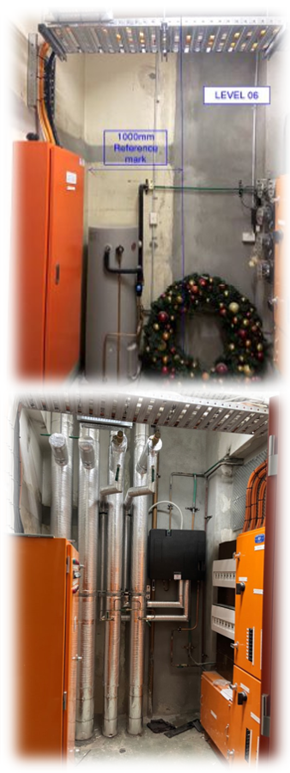
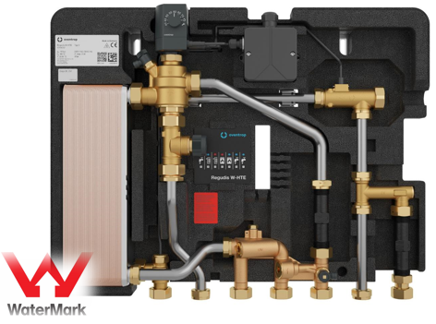
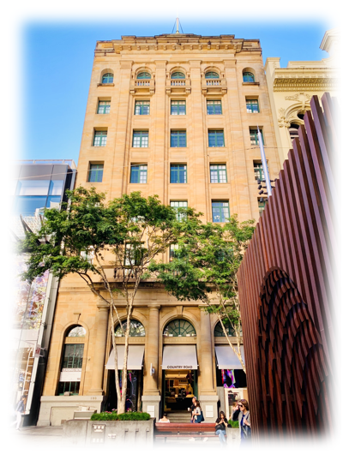
Case Study: DHW Upgrade - 180 Queen Street, Brisbane
Oventrop and Masterflow Solutions have provided new potable domestic hot water generation products at 180 Queen Street, Brisbane. Built in 1930 and managed by Cornerstone Property Services, this former National Australia Bank building was heritage-listed in 1992. Today, 180 Queen is a 7-storey building with street-level retail and six floors of commercial offices on Queen St Mall.
Oventrop was engaged by project design consultant, Floth, and base building HVAC refit contractor, Dewpoint Group, to replace the existing electric domestic hot water (DHW) tanks on each floor with Regudis Heat Interface Unit (HIU) stations. These compact water-to-water units deliver potable DHW via primary heating hot water (HHW) from the base building air-cooled Multifunction Heat Recovery Chillers.
Each floor was fitted with a Regudis W-HTE single-plate HIU, providing up to 21 L/min of 43°C domestic warm water supply (DWWS) via the plate heat exchanger (HEX) from the chiller’s continuous 48°C primary base building HHW supply. The Regudis HEX provides hydraulic separation between DWWS and primary HHW supply and ensures hygienic warm water is delivered to taps just in time, every time.
Regudis HIUs feature advanced electronic flow rate and temperature control. Their asymmetrical HEX plate arrangement minimises pressure loss and supports lower primary heating water temperatures without compromising high discharge flow rates and temperatures to taps.
Compliant with Australian Standards AS3500.4 clause 1.9.3 (as an appliance), Plumbing Codes of Australia, and local government warm water guidelines, Regudis HIUs eliminate the need for thermostatic mixing valves while ensuring system hygiene per DHW design requirements.
180 Queen Street exemplifies the ‘blue to green’ concept, where refits should be not only sustainable but also beneficial to environment, community, and user.
Oventrop Regudis W-HTE: the benchmark in hygienic potable hot & warm water systems
Forward thinking for tomorrow’s blue to green urban environments
regudis.oventrop.com | masterflow.net.au | floth.com.au | dewpointgroup.com.au

Slide 36
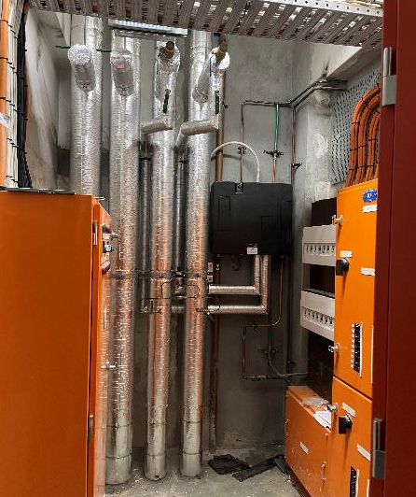
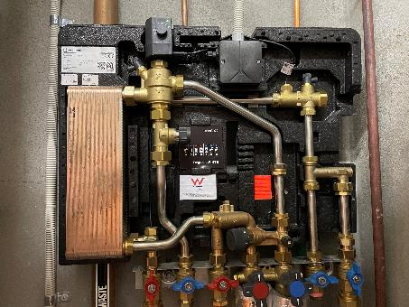
Designing with Regudis W
Commercial Office Refit
Project Requirement: Secondary Warm Water Per Floor
Female – 2x hand basins at 4.5 L/min each, 1x shower at 6.0 L/min
Male – 2x hand basins at 4.5 L/min each, 1x shower at 6.0 L/min
Kitchenette – 1x sink at 6.0 L/min
Cleaners – 1x sink at 6.0 L/min
With diversification, hours of use → 20 L/min per level required
Solution = Regudis W-HTE
Performance range 3-21 L/min @ 45°C, with
48°C min. primary HHW supply from 4-pipe HP/chiller
Notes:
180 Queen St Brisbane; 6 level refit
CHW and HHW system replaced with 4-pipe HP chiller at 48C primary heating water and Regudis delivers 43C to taps instantaneously as the stations are within 10m to furthest outlet.
(No different to location of traditional high temp DHW system TMV location)
To summarise, we don’t need high temp hot water circulating the entire system to ensure system sanitisation and hygiene when we have direct water-to-water heat exchange within 10m to furthest outlet.

Slide 37
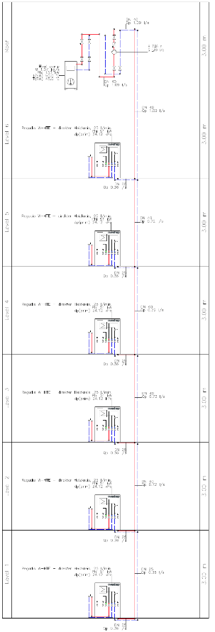
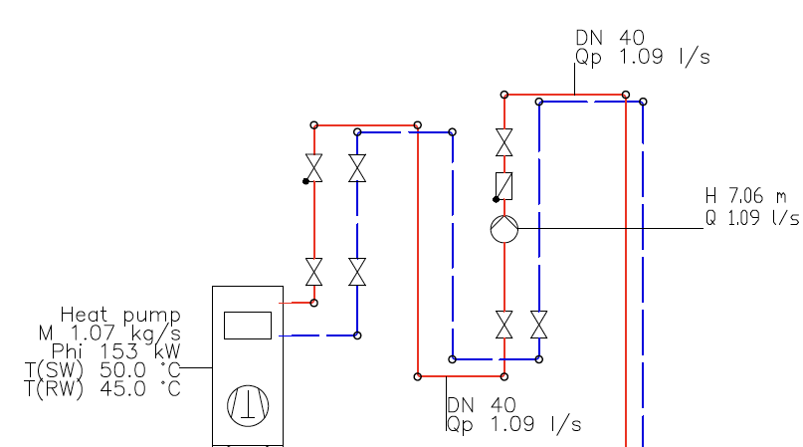
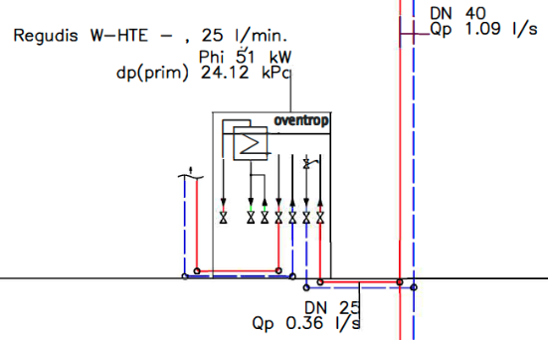
Designing with Regudis W
Commercial Office Refit
Requirement: Primary Heating Water System
Field primary HHW flow 1.09 L/s at 7.06m head
Direct fed primary HW system via HP peak 153kW.
Equal to 3x Regudis running simultaneously at tap rate of 20 L/min warm water supply.
Notes:
180 Queen St Brisbane; 6 level refit
In some applications, can be done without buffer. In this design, as we have an abundance of available kW at 48C from HP, no buffer stores required.
However at peak volume flow, each Regudis could consume 51kW.
Our simultaneous calculation has 3 Regudis units running at peak equaling 153 kW demand on HP

Slide 38
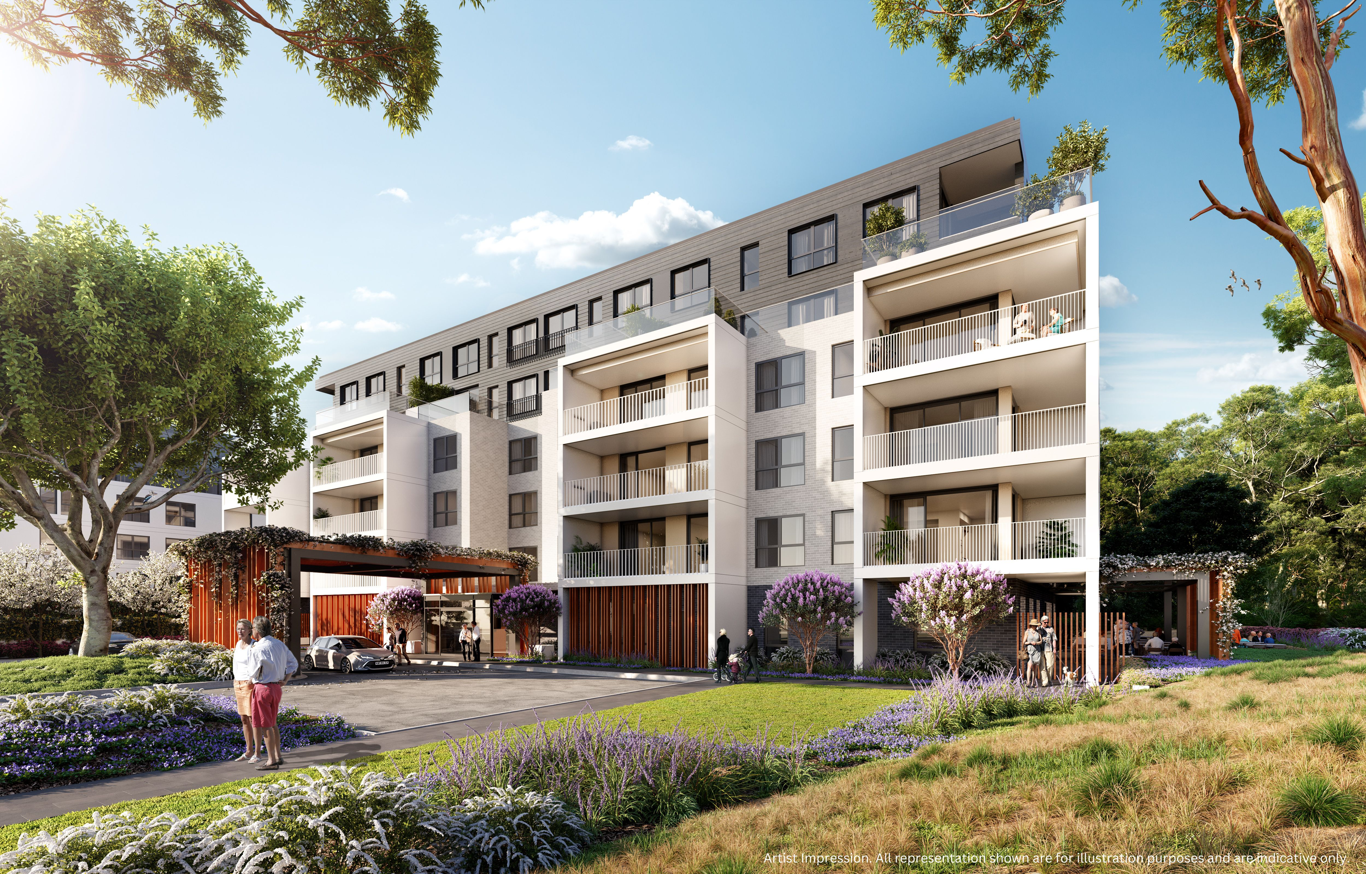

Kingfisher Grove Retirement Village
Regudis W-HTE Installation (Jordan Springs NSW)
Developer: Lendlease/Keyton Retirement Living Builder: Richard Crooks Construction
Overview:
The project has 142 domestic hot/warm water (DHW/DWW) Regudis stations.
It includes three six-story buildings with 139 apartments (1, 2, and 3 bedrooms).
Stage 1: Building A complete
36 apartments, communal areas, heated indoor pool, and support services.
36 DHW stations for apartments; 3 DWW stations for communal/support service areas.
Heating Systems:
Building A provides primary heating for all site apartments, communal areas and services. Small main plant & local Regudis footprint = more lettable space for developer.
150 kW heat pump @ 65°C supplies 4,500L storage, meeting peak DHW demands (without oversized HP) with coefficient of performance (COP) of 3.2.
Eliminated need for additional electrical substation and sitewide infrastructure saving developer over $500k.
Quick DHW/DWW tapping time for residents = reduce water usage & complaints for developer.
Tap temperatures maintained at 60°C (DHW) for apartments and 43°C (DWW) for communal areas, continuously.

Slide 39

Designing with Regudis W
Case Study – Kingfisher Grove
Project
144 apartments across three buildings
Requirement
Instantaneous domestic potable HW delivery @ 60°C via Building A basement plantroom air-to-water HP system
Solution
Regudis W-HTE
Outcome
Eliminated ‘extra’ electrical substation (vs initial design*)
*144x 18kW 3-phase electric instantaneous HW systems plus requisite power cabling infrastructure for each building
Notes:
Kingfisher
Additionally, we eliminated the need for an extra electrical substation in the initial design for domestic hot water (DHW), which included 144, 18 kW 3-phase electric instantaneous hot water systems (one per apartment), along with the required power cabling infrastructure within each building

Slide 40






Kingfisher Grove
Regudis W-HTE Installation

Slide 41





Kingfisher Grove
Primary Heating Plant – Heat Pump & Storage

Slide 42



Kingfisher Grove
Primary HW Network
Note:
Building A has a 150-kW heat pump system that supplies water at 65°C. This system includes a 4500L buffer storage, strategically sized to meet future DHW demands for all buildings in Kingfisher Grove, including Buildings A, B, and C.
Building A
Building B
Building C
Typical floor Regudis W-HTE apartment connection & pipe size
Notes:
Demo of design network for three buildings all completed by Oventrop which you can take and overlay into your design as you wish.
Main plant layout on left, Typical floor connection of Regudis without need for balancing valves as each unit has its own PIC capability.
We offer full schematics pipe detail, Rob said this is what we offer and then explained a bunch of things relevant to this pipe schematic.

Slide 43

Kingfisher Grove
Overview
150 kw at 65°c Clivet / Masterflow heat pump
4,500 litres of buffer storage
Primary & secondary HHW pumps
Provision to extend to buildings B & C
142x Regudis stations in total
Associated expansion tanks, dosing pot and switchboard with Regtronic plantroom controls
Primary Heating Water Plant BIM Design
Secondary Flow
Secondary Return
Primary Flow
Primary Return
Notes:
BIM design by consultant
Air source HP in plant room (not often done) but can be workable solution with air dynamics design overlays.
Ask rob what the hit point was relating to the size of the plant – how much is it serving and whay was it so wow for Cundall?

Slide 44
Designing with Regudis W
Case Study – Commercial Tower
Project
Commercial Tower
Requirement
Instantaneous domestic potable HW delivery @ 45°C via rooftop plantroom air-to-water HP system.
Distribute to office tower amenities & basement EOT facility.
Solution
Regudis W-HTE

Slide 45
Designing with Regudis W
Design Case Study – Commercial Tower
Project requirement: Secondary Potable Hot Water
Office Tower Amenities (OTA) levels 1 to 23 at 45°C, each consist of:
OTA Female – 2x hand basins
OTA Male – 2x hand basins
OTA DDA – 1x hand basin
OTA Cleaners – 1x sink
End Of Trip (EOT) facilities consist of:
EOT Female – 8x showers, 4x hand basins, 1x cleaners sink at 45°c
EOT Male – 12x showers, 8x hand basins, 1x cleaners sink at 45°c
EOT DDA – 1x shower, 1x basin at 43°c
Notes:
Commercial tower where requirement for entire building is only for 43C at taps, including EOT.
Therefore, main plant does not need to exceed 55C supply (energy savings).

Slide 46
Designing with Regudis W
Design Case Study – Commercial Tower
Project requirement: Primary Heating Water System Schematic
~
~
15 similar levels
Notes:
Initially HP meant to serve EOT only. However, given efficiency of proposed design, solution expanded to include 23 floors of amenities as well. Plant moved to roof with single 46kW HP @ 55C w/ 3000L buffer store to serve EOT plus entire building’s amenities and eliminate gas boiler plant.

Slide 47

Designing with Regudis W
Design Case Study – Commercial Tower
Project requirement: Primary Heating Water System
Field secondary HHW flow 7,916 m³/h or 2.2 L/s
Controlled by field DP sensor & Regumat variable speed pump
Regtronic RD-W plant controller further optimises system efficiency
365 kW peak load capability, with 33.8% buffer reserve. Providing 24 minutes continuous hot water deliver without heat pump recharge
Requires 1 off 45.8 kW HP suppling 55°C primary HHW
Notes:
Stand alone DHW plant controls requested for this project:
Supplied Regtronic RD-W plant controller in lieu of BMS, otherwise site BMS can also control plant and tank loading requirements.

Slide 49

Distributor
Masterflow Solutions
Scott Pringle – Business Development Manager
scott.pringle@masterflow.net.au
+61 447 537 055
Roy Hales – National Accounts Director
roy.hales@masterflow.net.au
+61 438 460 310
Masterflow Solutions
Global Brands & Local Expertise Done Better
Sydney (HQ) 02 9748 2022
Melbourne 03 9012 9751
Brisbane 07 3103 7055
www.masterflow.net.au

